Slide 1
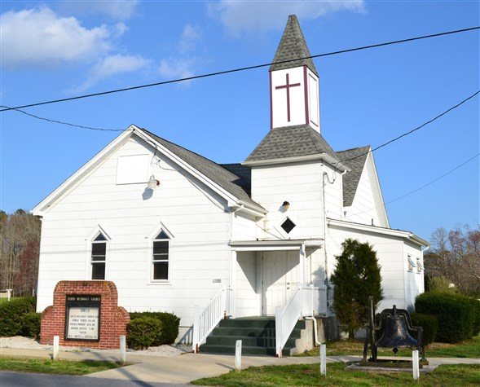
Curtis United Methodist Church Bible Study
Facilitator
LaVaughn W. Price, Sr., Pastor

Slide 2
Acts Lesson IV Part I
Acts 4:11-12 Chief Corner Stone
Matthew 7:13-14 The Narrow Way
Acts 4:13 Boldness of Peter & John

Slide 3
Acts Lesson IV Part I
Acts 8:1 Saul consented to persecution
Acts 11:19 Barnabas & Saul at Antioch
Acts 4:13 Unlearn & Ignorant Men

Slide 4
Acts Lesson IV Part I
Acts 4:14-17 What to do with the two
Acts 4:18 Peter & John was commanded
Acts 4:19-22 Everyone glorified God

Slide 5
Acts Lesson IV Part I
Acts 4:23 Peter & John went to companions
Acts 11:25-26 Barnabas went to Tarsus
Acts 4:24-28 Everyone was guilty

Slide 6
Acts Lesson IV Part I
Acts 2:23 God knew the outcome
Eph 1:11 We have gotten and Inheritance
II Tim 1:9 God calls us with Holy calling

Slide 7
Acts Lesson IV Part I
Acts 4:29-31 The rehearsal
Acts 32 There were no arguments
Acts 4:33-37 Wealth brought to disciples

Slide 8
Acts Lesson IV Part I
Acts 4:29-31 The rehearsal
Acts 32 There were no arguments
Acts 4:33-37 Wealth brought to disciples

Slide 9
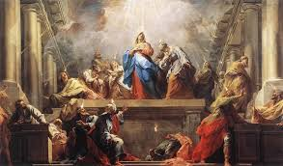
Acts Lesson IV Part II

Slide 10
Acts Lesson IV Part II
Matthew 10:5 Sending Out the Twelve
Matthew 15:24 Lost Sheep of Israel
Romans 15:8 Servant for the circumcision

Slide 11
Acts Lesson IV Part II
Acts 4:34-37 The rehearsal
Acts 5:1-5 Ananias & wife held back funds
Acts 5:6-11 They both died

Slide 12
Acts Lesson IV Part II
Acts 5:12 Signs and Wonders
Acts 1:8 Holy Ghost came upon them
Acts 5:12 They both died

Slide 13
Acts Lesson IV Part II
Acts 5:13-14 They respected them
Acts 5:15-17 The sick were brought to them
Acts 5:18-19 The Lord opened the jail doors

Slide 14
Acts Lesson IV Part II
Acts 5:20-26 Apostles on trial again
Acts 5:27-28 They appear before the council
Acts 5:29-30 The Lord opened the jail doors

